Slide 1


SIMple storage services

Slide 2
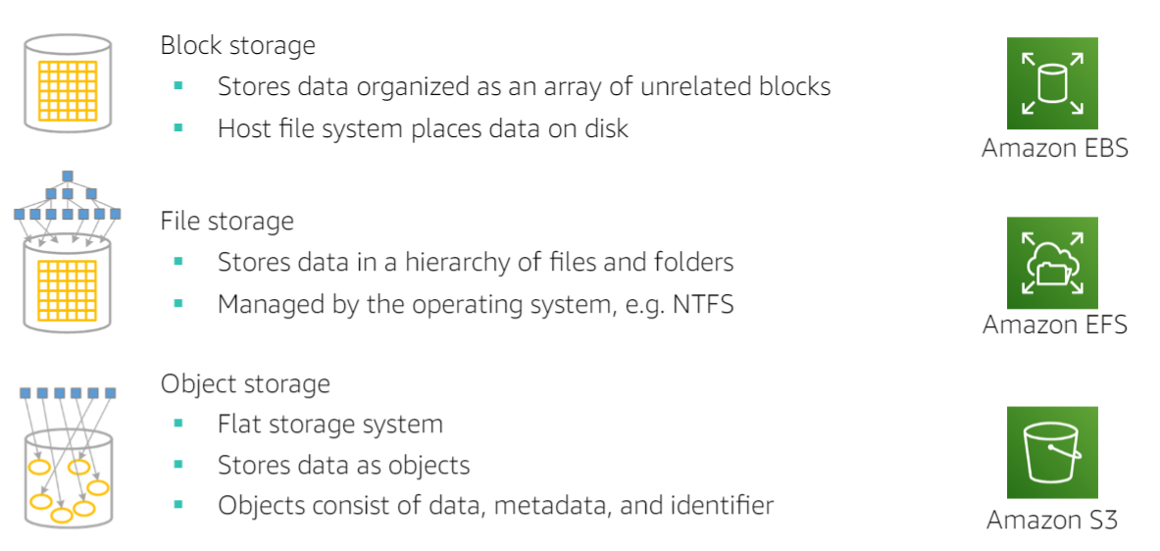

Different types storages

Slide 3
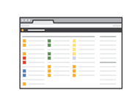



HOW IT IS USED
AWS Management Console
AWS Command Line Interface
AWS Software Development Kit

Slide 4
HOW TO create buckets?
Bucket Name
Region and Public Access Setups
Encrypt
Enable Lifecycle management options
Version
Object level logging
Server Access Logging
Static site logging

Slide 5
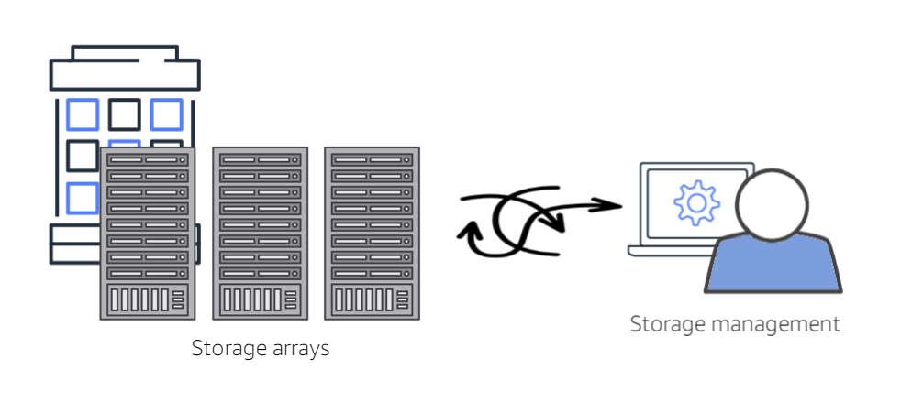
Problems normal storage

Slide 6
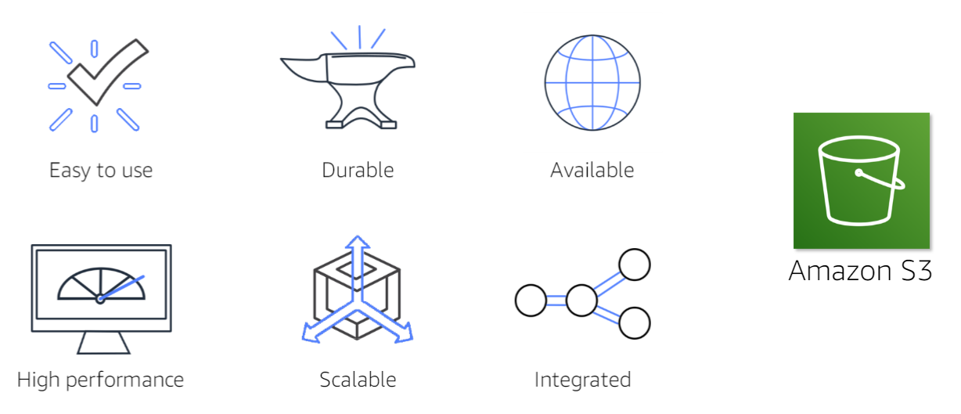
Important features

Slide 7
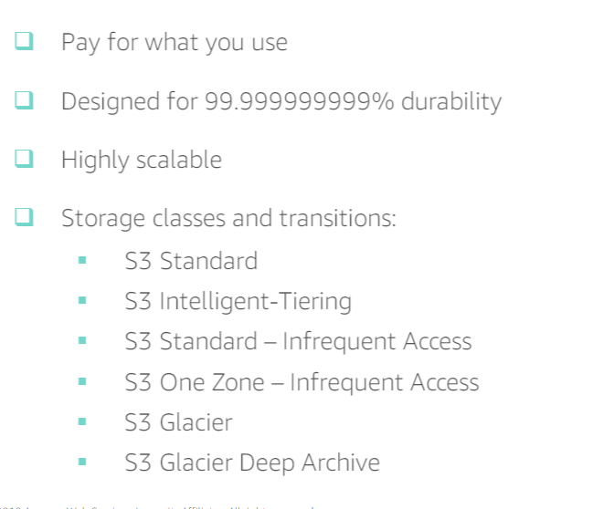

Problems normal storage

Slide 8
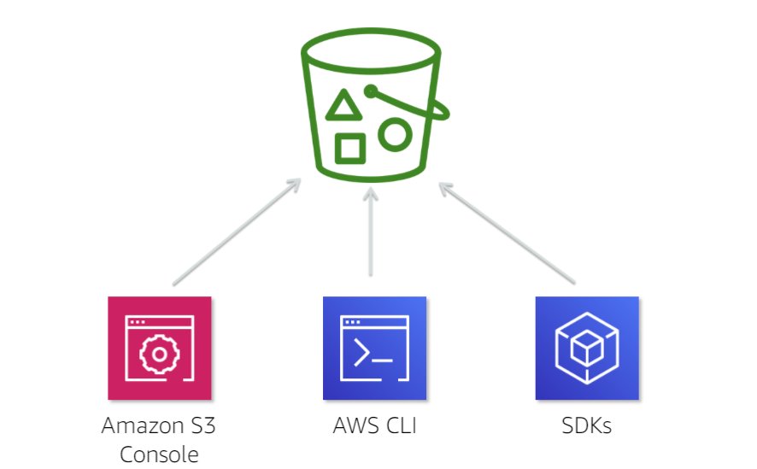
Problems normal storage

Slide 9
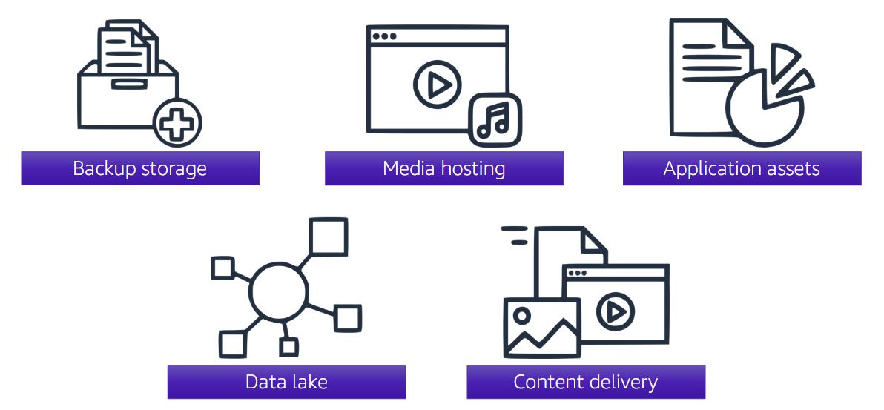
Problems normal storage

Slide 10
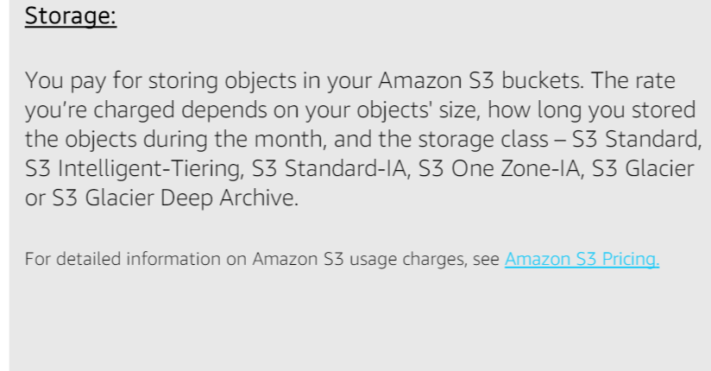
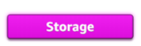
S3 charges

Slide 11
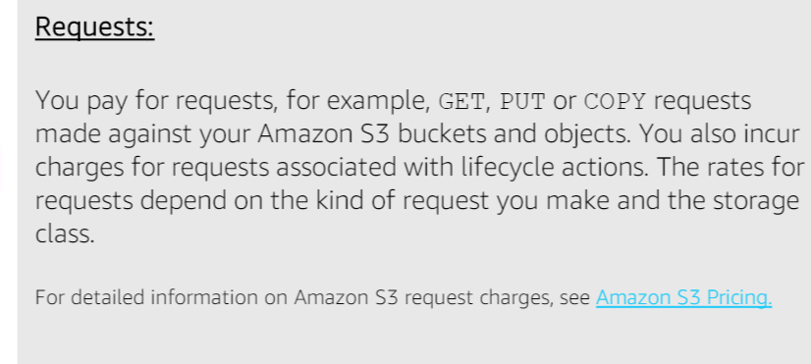
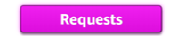
S3 charges

Slide 12
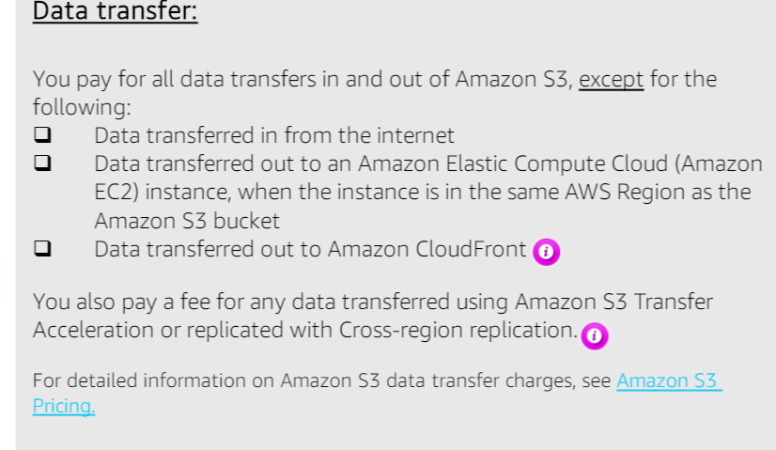
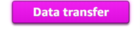
S3 charges

Slide 13
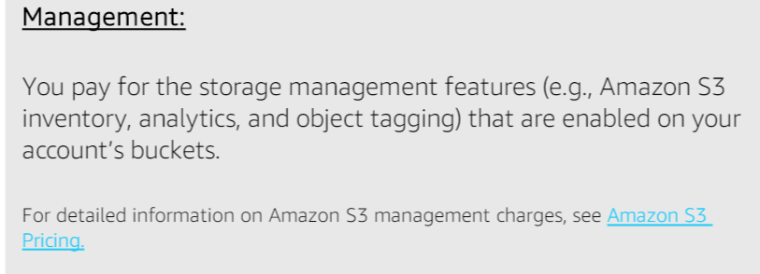
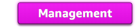
S3 charges

Slide 14
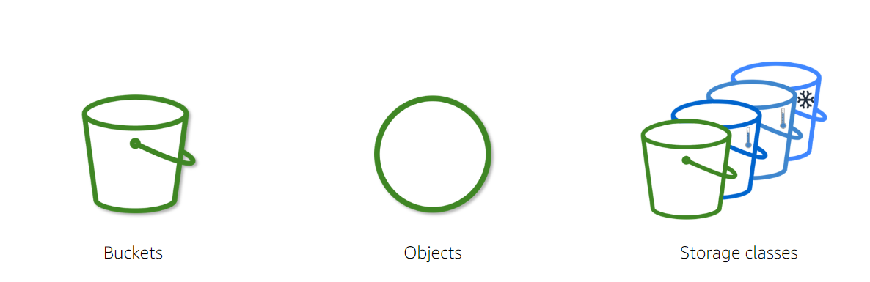
Key components s3

Slide 15
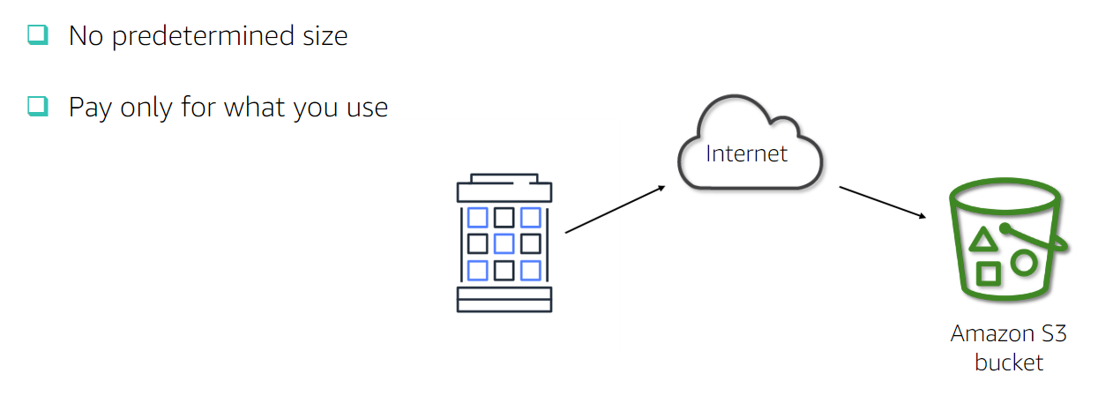
Properties of buckets

Slide 16
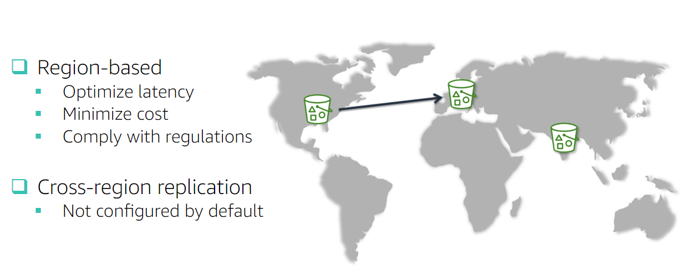
Location of buckets

Slide 17
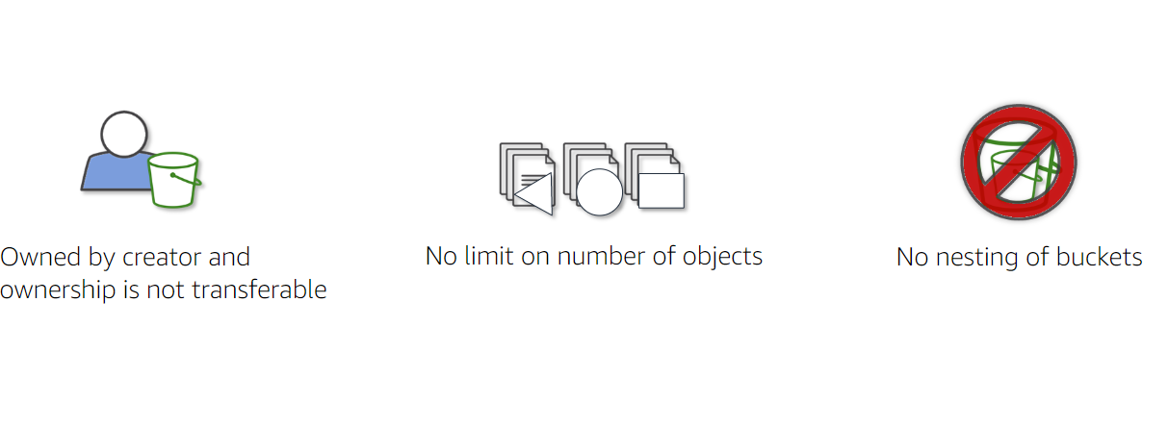
More properties on buckets

Slide 18
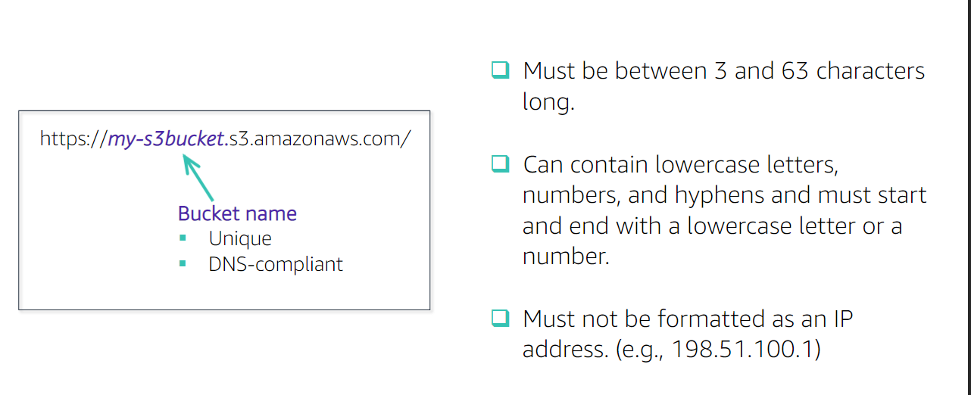
Rules for creation of buckets

Slide 19
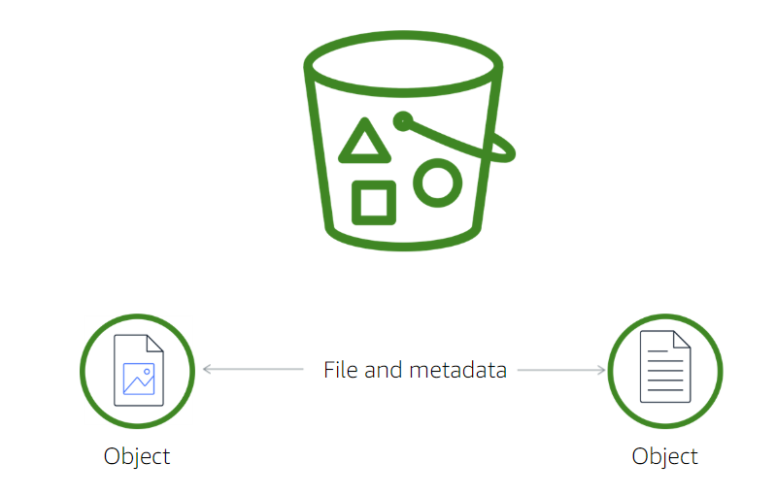


What are objects

Slide 20
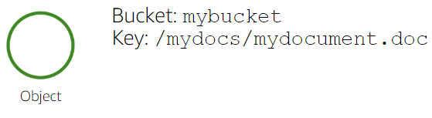
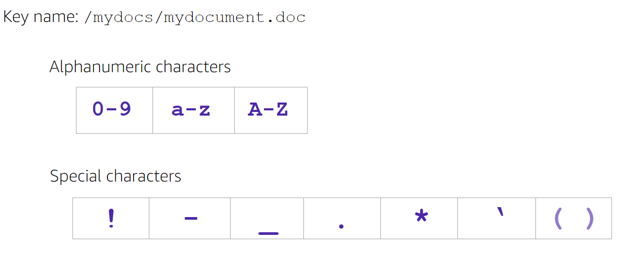

Rules for key names

Slide 21
Metadata of objects
Bucket : myBucket
Key: /mydocs/setups/setupDB.doc
VersionID
Value: Object can be less than 0-5 TB
Metadata:
Creation time and date
Content type
Storage class
Access Control Information

Slide 22
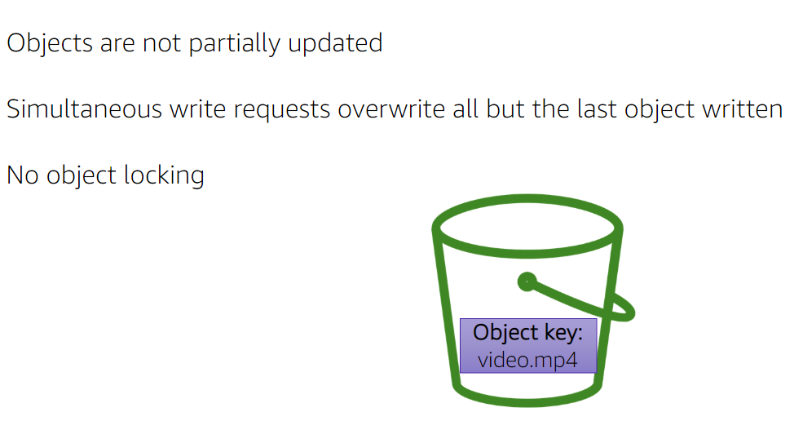
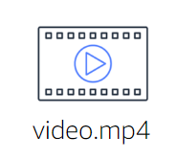
Uploading of object process

Slide 23
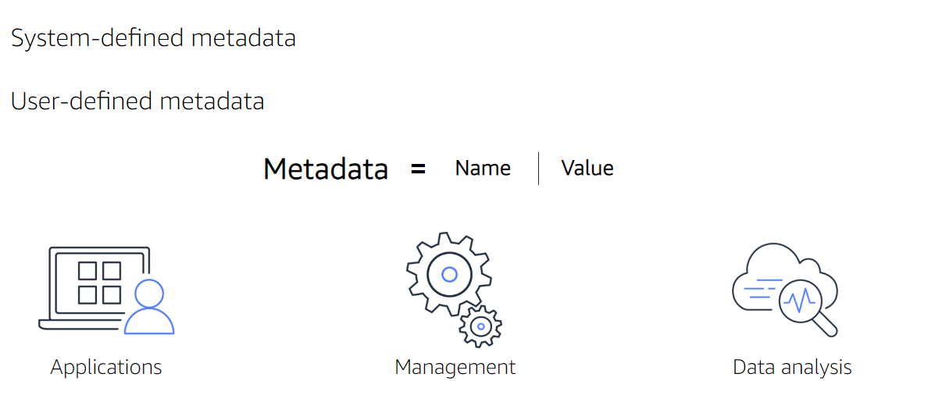
Types of the meta data

Slide 24
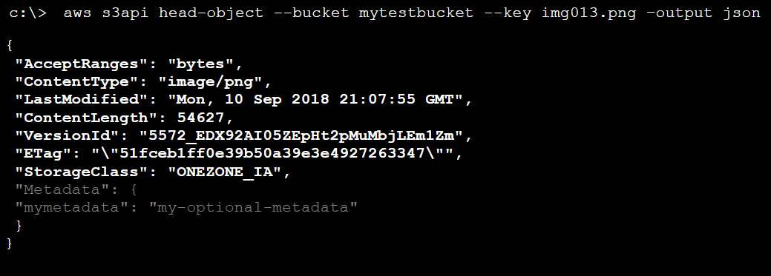
Getting object meta data

